Slide 1
Classificação
Recuperação de Informação
Renan Stephano Barbosa de Souza Rodrigues

Slide 2
Etapas
1- remover html tags:
public static String html2text(String html) {
return Jsoup.parse(html).text();
}
http://stackoverflow.com/questions/240546/remove-html-tags-from-a-string
2 - retirar os stop words
http://stackoverflow.com/questions/35319544/removing-stopwords-java
remover usando expressão regular:
// instead of the ".....", add all your stopwords, separated by "|" // "\\b" is to account for word boundaries, i.e. not replace "his" in "this" // the "\\s?" is to suppress optional trailing white space Pattern p = Pattern.compile("\\b(I|this|its.....)\\b\\s?"); Matcher m = p.matcher("I love this phone, its super fast and there's so much new and cool things with jelly bean....but of recently I've seen some bugs."); String s = m.replaceAll(""); System.out.println(s);

Slide 3
Etapas
2- criar um bag of words
https://www.youtube.com/watch?v=jSZ9jQy1sfE
@relation relevates
@attribute Document string
@attribute relevante {yes, no}
@data
"... string... ", no
"... string... ", yes...

Slide 4
Etapas
3-Usar Principais classificadores
– Naïve bayes
– Decision tree (J48)
– SVM (SMO)
– LogisTc regression (logisTc)
– MulTlayer perceptron
5- treino de validação cruzada
https://www.youtube.com/watch?v=72LXnrT0qIY

Slide 5
Exemplo Seleção dos sites
http://www.lebes.com.br/
relevante
http://www.lebes.com.br/som-e-video/tvs-led
http://www.lebes.com.br/tv-led-24--semp-l24d27-conversor-digital/p
http://www.lebes.com.br/smart-tv-led-58-samsung-un58h5203agxzd-full-hd-com-conversor-digital-563357/p
http://www.lebes.com.br/tv-led-40--full-hd-samsung-hg40nd450bgxzd-usb-hdmi-modo-filme---bivolt-560432/p
http://www.lebes.com.br/smart-tv-led-32-hd-samsung-un32j4300-usb-hdmi-wi-fi-conversor-digital-558858/p
http://www.lebes.com.br/smart-tv-led-43--lg-43lh5700-full-hd-com-conversor-digital-565630/p
http://www.lebes.com.br/smart-tv-led-43--semp-toshiba-43l2500-full-hd-com-conversor-digital-565035/p
http://www.lebes.com.br/tv-samsung-led-32--hd-samsung-hg32nd450sgxzd-hdmi-usb---conversor-digital---bivolt-560431/p
http://www.lebes.com.br/tv-led-14--semp-le1473-hdmi-conversor-digital/p
http://www.lebes.com.br/smart-tv-led-semp-toshiba-tcl-49--l49s4900fs-full-hd---com-conversor-digital/p
não relevante
https://s3-sa-east-1.amazonaws.com/cdn.siteblindado.com/lp_aw/verifica-pt-br.html?url=www.lebes.com.br
http://www.ebit.com.br/lojas-lebes
http://www.lebes.com.br/brv

Slide 6
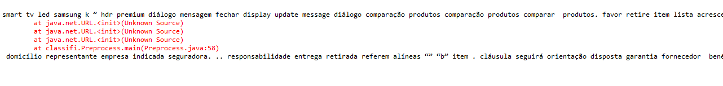
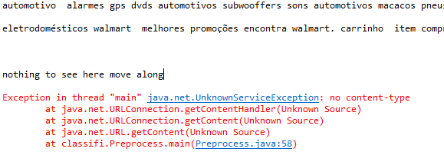
Problemas
A maioria dos grandes portais estavam blindados.

Slide 7
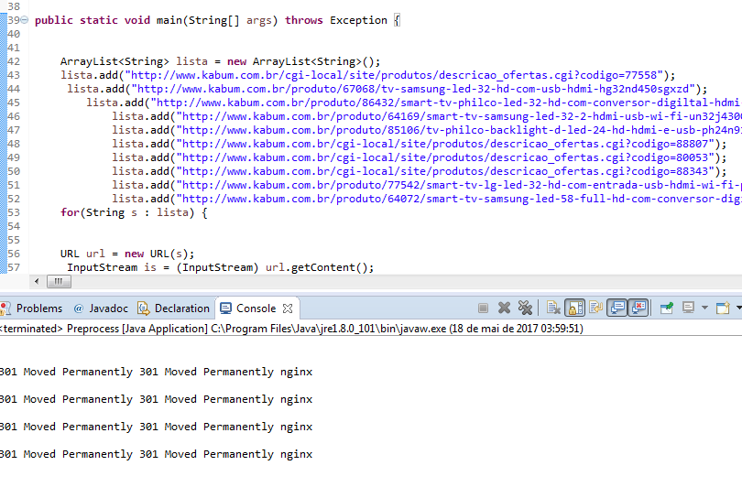

Slide 8
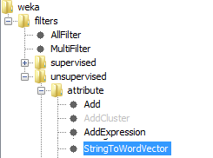
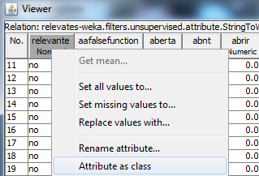
Criação do bag of words *(Usando o Weka)

Slide 9
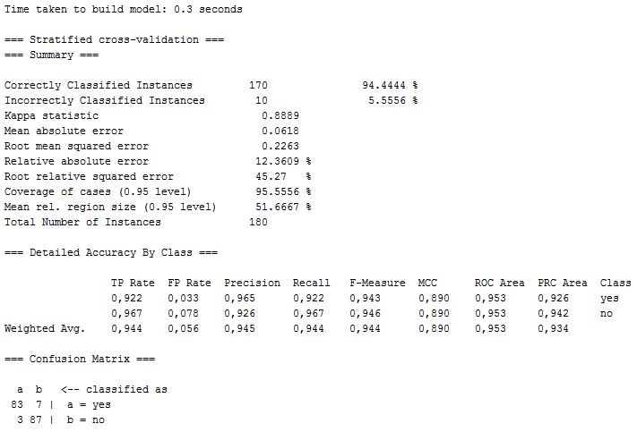
J48

Slide 10
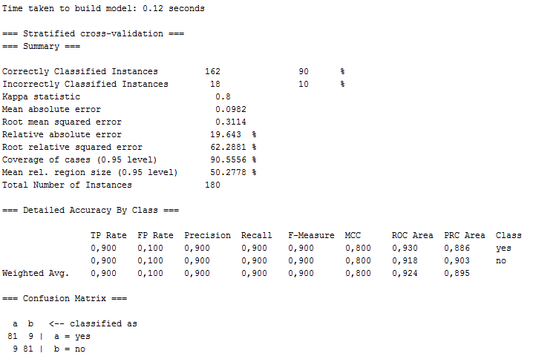
Naive Bayer

Slide 11

SMO

Slide 12
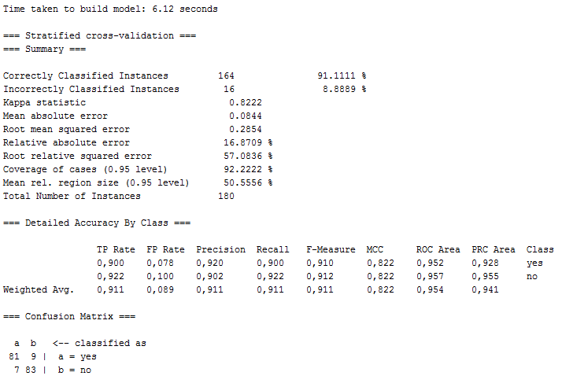
Logist Model

